Slide 1

HR Attrition Analysis
By: Sarah Steinbaum

Slide 2

Objective
Our organization is growing at a rapid rate. However, employees are leaving the company by what leadership believes is due to a lack of direct engagement and job satisfaction. Specifically, the questions we will address are:
Why are employees leaving the organization and what metrics can we use to gauge attrition?
What changes does our organization need to make in order to retain employees?

Slide 3
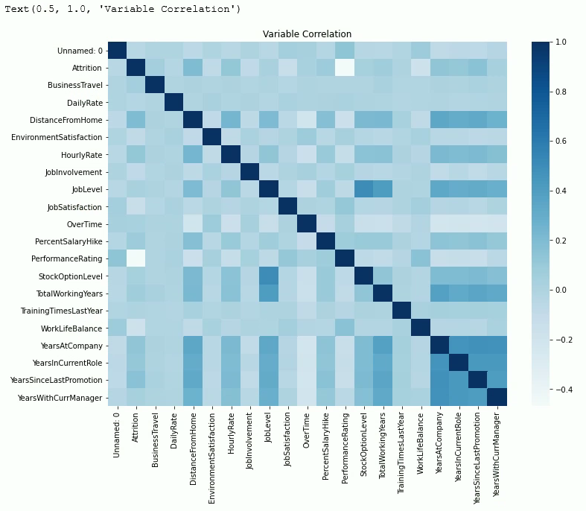
Analysis
An Exploratory Data Analysis (EDA) was conducted to determine what factors impact attrition. First, a baseline was established using data provided by HR. This data was merged, cleaned, and reviewed to use for the analysis. Some variables were removed as they did not pertain to the objective of the analysis.
A correlation matrix was created to determine what variables impact attrition. The first visual is a heatmap that portrays the correlation on a gradient scale in blue with a darker shade indicating a strong positive correlation. Then, a logistic regression and a random forest model were created to determine the accuracy of the model. The accuracy of the logistic regression model was 81% and the random forest was 86%.

Slide 4
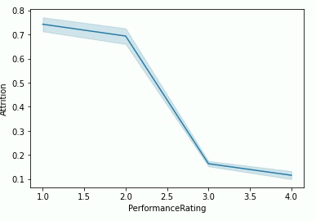
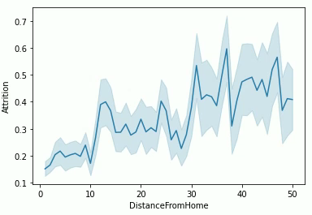
Analysis Continued
The line graphs demonstrate the effect of attrition on the variables,
PerformanceRating
DistanceFromHome
The variable, DistanceFromHome, had the strongest positive correlation while PerformanceRating had the strongest negative correlation.
Employees with a higher performance rating were less likely to leave.
Employees were more likely to leave as the distance from home increased.

Slide 5
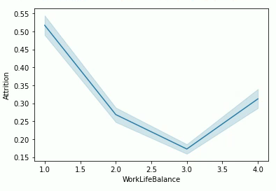
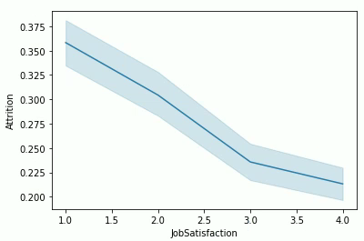
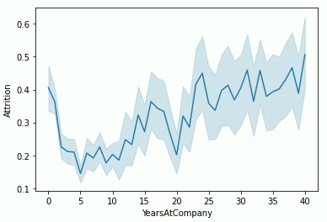
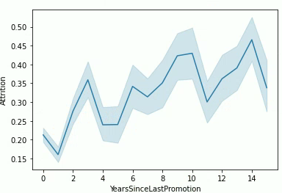
Analysis Continued
These line graphs show the variables against Attrition individually.
WorkLifeBalance
JobSatisfaction
YearsAtCompany
YearsSinceLastPromotion
The graphs show that as WorkLifeBalance and JobSatisfaction increase, attrition generally decreases.
It also shows that as YearsAtCompany and YearsSinceLastPromotion increase, attrition also increases.

Slide 6

Results
The analysis determined that the variables DistanceFromHome, PerformanceRating, YearsSinceLastPromotion, YearsAtCompany, HourlyRate, JobSatisfaction, and WorkLifeBalance have an impact on attrition.
Recommendations To Increase Employee Retention:
Offer remote or hybrid options to decrease their distance to work and improve their work-life balance.
Adjust the employee performance rating criteria
Provide deserving employees with a good performance rating that includes an hourly raise and possibly a promotion. This should lead to increased job satisfaction and improve attrition.
Provide incentives for employees to stay longer with the organization such as an increase in pay or time off.

Slide 7
References
Introduction to scikit-learn (sklearn) in python • datagy. datagy. (2022, January 5). https://datagy.io/python-scikit-learn-introduction/
Reddy, E. P. K. (2021, March 25). Step by step process of feature engineering for machine learning algorithms in Data Science. Analytics Vidhya. https://www.analyticsvidhya.com/blog/2021/03/step-by-step-process-of-feature-engineering-for-machine-learning-algorithms-in-data-science/
Sun, E. D., Ma, R., & Zou, J. (2022, December 30). Dynamic visualization of high-dimensional data. Nature News. https://www.nature.com/articles/s43588-022-00380-4
Choosing colormaps in matplotlib#. Choosing Colormaps in Matplotlib - Matplotlib 3.7.1 documentation. (n.d.). https://matplotlib.org/stable/tutorials/colors/colormaps.html

